Slide 1
CSE 8990: Graph Machine Learning
Instructor: Zhiqian Chen
Dept. of Computer Science and Engineering

Slide 2
Agenda of This Week
Basic Information of this Course
Grading Policy
Course Schedule
Overview of Graph Machine Learning (GML)

Slide 3
Basic Information
Time: Tuesday. & Thursday, 11:10am - 12:25pm
Location: WALKER 320
Website: Canvas
Instructor: Zhiqian Chen, zchen@cse.msstate.edu
Office Hour: Appointment via Webex/Phone
Delivery: Face to Face

Slide 4
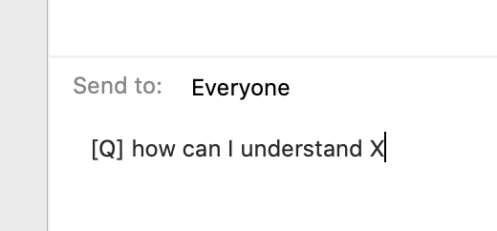
Have A Question in Class?
Raise your hand OR
Webex chat: with [Q] prefix
All questions will be answered or posted for discussion

Slide 5
Prerequisites
Basic Knowledge
Basics of Machine Learning
Algorithms and Coding
Introduce your academic background in Assignment 1

Slide 6
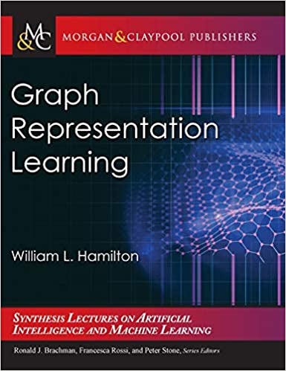
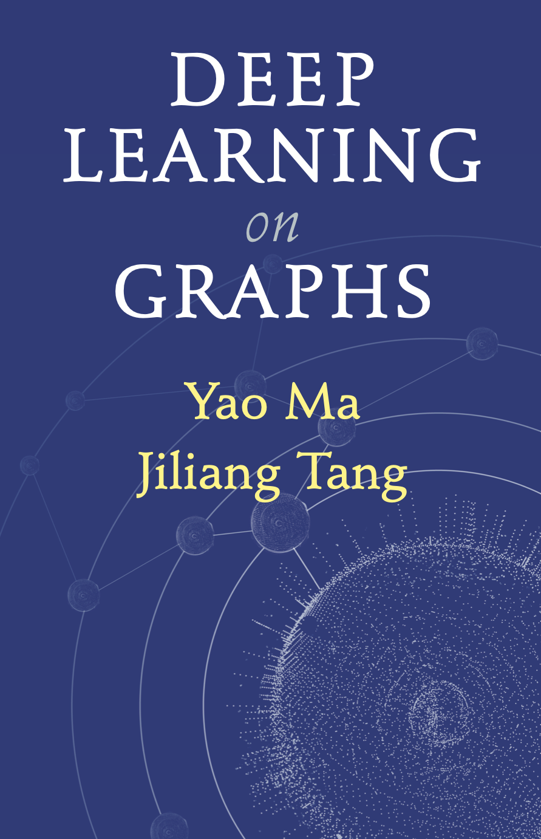
Readings
Graph Representation Learning
William L Hamilton, 2020
Deep Learning on Graphs
Yao Ma and Jiliang Tang, preprint

Slide 7
Readings
Resources Collection
Surveys, Tutorials, Books, Courses, Papers
https://github.com/thunlp/GNNPapers
https://github.com/zlpure/awesome-graph-representation-learning
https://hhaji.github.io/Deep-Learning/Graph-Neural-Networks

Slide 8
Grading Policy
10% Participation
In-class quiz, Attendance, Discussion, Survey, Course Feedback
20% Homework (10%*2)
20% Take-home Midterm
50% Course Project:
Paper Reading: 20%
Project: 30%

Slide 9
Discussion and Participation
In-person Attending
If feeling sick/ uncomfortable, asymptomatic contagious infection or potential exposure to contagious infection, report to the instructor, and stay home, and try to attend online if possible

Slide 10
Homework Assignment
2 homework Assignments
A combination of data analysis, algorithm design, and math
Submit in Canvas with Google Colab link
Due in 2 weeks

Slide 11
Midterm Exam
Take-home exam
Mid-term, Oct. 4-8 (five days)
No final exam

Slide 12
MSU Honor Code
We strictly enforce the MSU Honor Code. Violations include:
Copying or allowing another to copy
Unpermitted collaboration
Plagiarism
Giving or receiving aid on a take-home examination

Slide 13
Course Project
Project topics:
Instructor will provide a list of example topics.
Each group can either select one topic
Each group need to read the given papers, and propose a project based on the papers/topic
If you are concerned, talk to the instructor and start the project early

Slide 14
Course Project (cont.)
Timeline
Sept. 14: Group Member List (2 ~ 3 students) and Topic Selection
Oct. 14: Project Proposal
Nov. 16: Project Presentation Slides
Dec 7: Project Report

Slide 15
Topic Pool
Directed Graph Modeling
Model Neural Network as Graph
Graph Matching
Molecule/Protein Graph for Drug/Material Discovery
Theoretical Geometric Deep Learning
Influence Maximization/Minimization
Combinatorial Optimization on Graphs
Explainable AI for Graph Neural Networks

Slide 16
Paper Reading
How to read a paper?
How to review a paper By Elisabeth Pain
How to (seriously) read a scientific paper
Andrew NG: Reading Research Paper
How to Read a Paper
How to read a research paper

Slide 17
Project Proposal
A team consisting of up to 5 students.
The proposal must contain:
Task Definition: Describe what you plan to do
Literature Review: Briefly describe the related work
– Relationship with your readings
Motivation: Describe why your project is important
Method: What technique you plan to apply?
Evaluation: What would the successful outcome of your project look like?

Slide 18
Project Presentation
Project presentation must contain:
Motivation.
Drawbacks of related work
The proposed Method
Evaluation
Paper + Project presentation 35 min

Slide 19
Project Report
The project report is expected to be 6-8 pages long (excluding references) in IEEE format and should contain the following sections:
Introduction
Related Work
Proposed Method
Experiments (codes and datasets should be open to the public)
Results and Discussions
Conclusions
Contributions of Members

Slide 20
Course Overview
Basics of Graph Theory
Graph Signal Processing
Graph Machine Learning

Slide 21
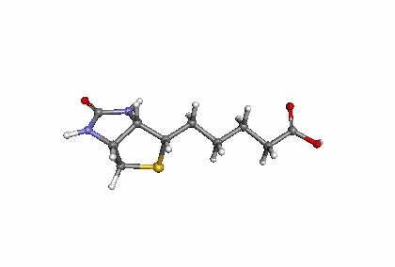

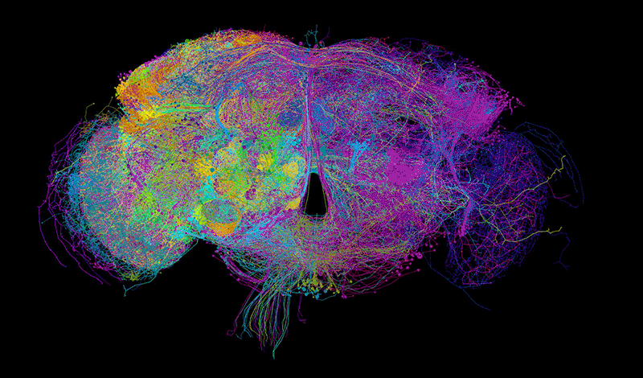
Graph Examples
2D/3D Chemical structure generation, chemical reaction synthetic
Social Network
Functional Connectivity and Structural Connectivity in Human’s Brain

Slide 22
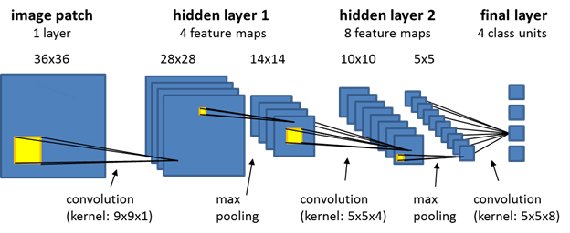
Why is it Hard
Main question:
How do we take advantage of relational structure for better prediction?
Modern deep learning toolbox is designed for grids (or sequence)

Slide 23
Course Topics
Basics
Graph Theory: Basic Concepts
Spectral Graph Theory: Basic Concepts
Spectral Graph Clustering
Graph Fourier and Wavelets
Examples
Graph Neural Networks: GCN
Graph Neural Networks: GraphSAGE
Graph Neural Networks: DeepWalk, Node2Vec
Graph Neural Networks: PageRank, DeepGCN
Explanation Frameworks
Graph Convolution: Function Approximation perspective
Graph Convolution: ODE/PDE perspective
Explainable AI for Graph: GNNExplainer
Special Topic: Influence Maximization
Scientific Computation and Tools for Graph Analysis

Slide 24
Typical Task of GML
Clustering: Detect if nodes form a community
Example: community detection
Node classification: Predict an attribute of a node:
Example: Categorize users / items
Link prediction: Predict whether there are links between two nodes
Example: Knowledge graph link prediction
Graph classification: Categorize different graphs
Example: Molecule property prediction
Graph generation: Drug discovery
Graph evolution: Physical simulation

Slide 25
Graph Theory: Basic Concepts
How to represent a graph?
Adjacency, Laplacian matrix
What are the differences/pros/cons among those representations.
Study the spectrum of adjacency or Laplacian matrix of graphs

Slide 26
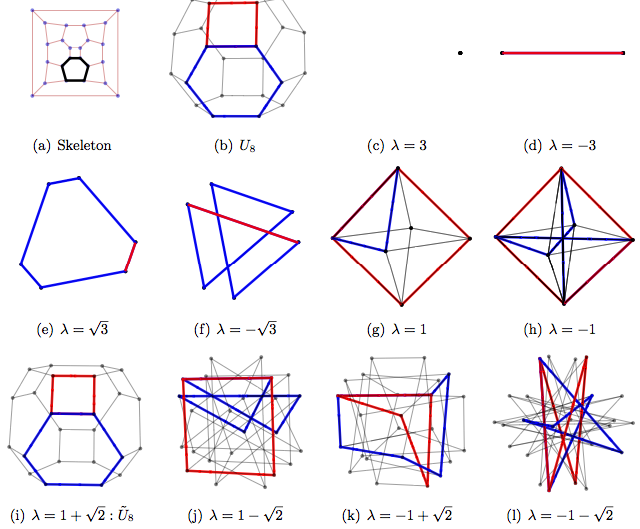
Spectral Graph Theory: Basic Concepts
eigenvalue <-> graphs

Slide 27
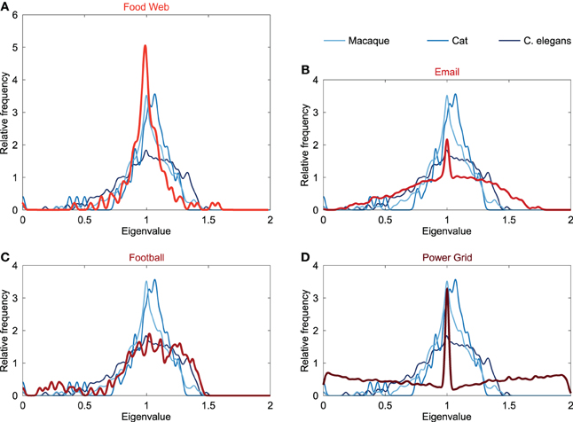
Spectral Graph Theory: Basic Concepts
The Laplacian spectrum of neural networks, Frontiers, 2014
Spectrum Density Function <-> Graphs

Slide 28
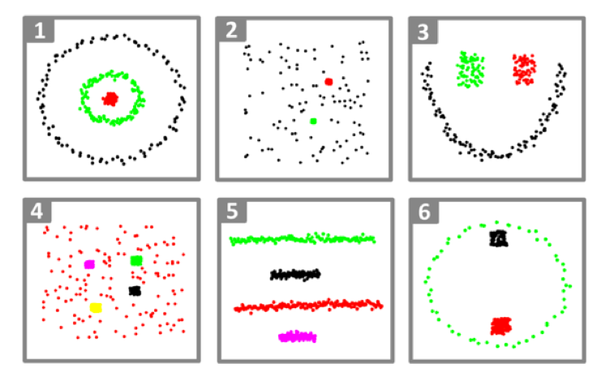
Spectral Graph Clustering
Based on eigenvectors
Global perspective
Robust
Handle non-linearity

Slide 29
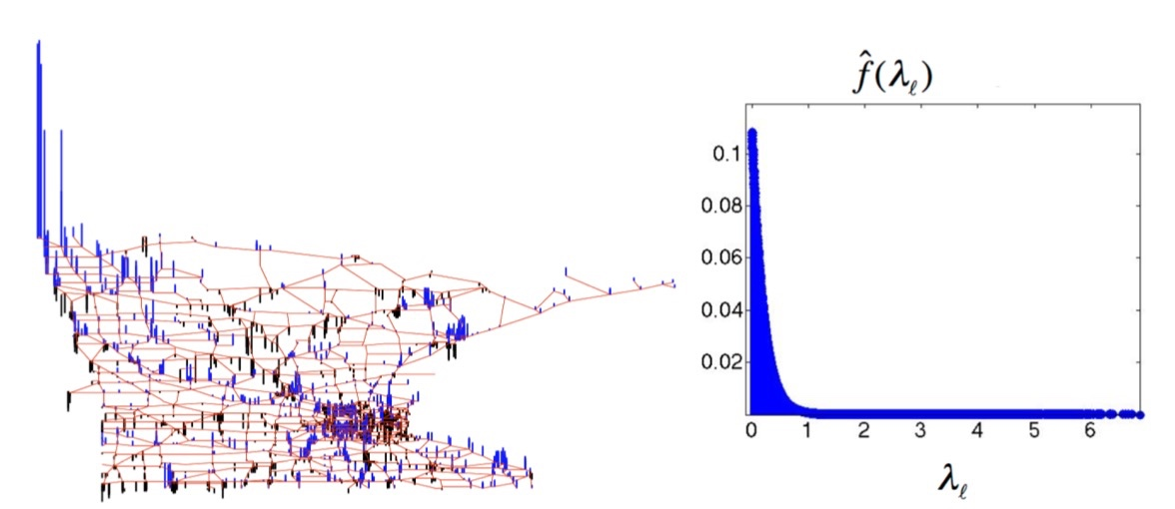
Graph Fourier and Wavelets
Graph Fourier Transform
Spectral Domain
Graph Wavelet Transform
Spectral and Spatial Domain
Extension of Fourier transform
Control scale, location

Slide 30
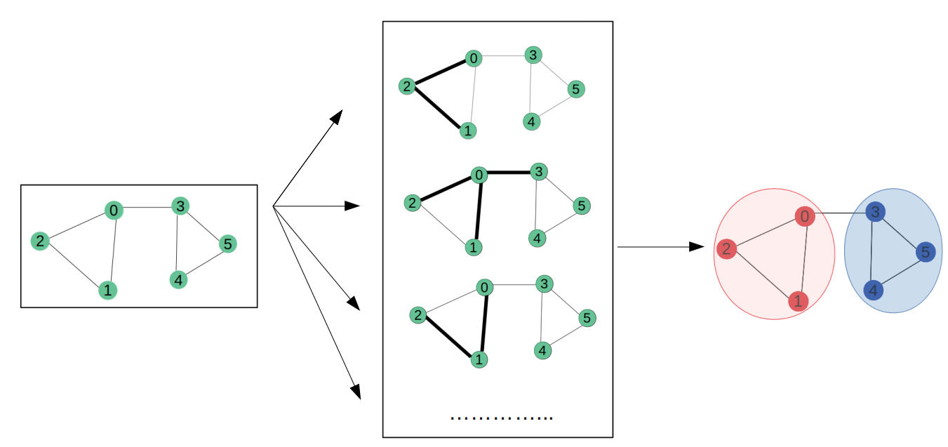
Graph Neural Networks: GCN
Hidden Features with Eigenvectors
Input
Node Classification

Slide 31
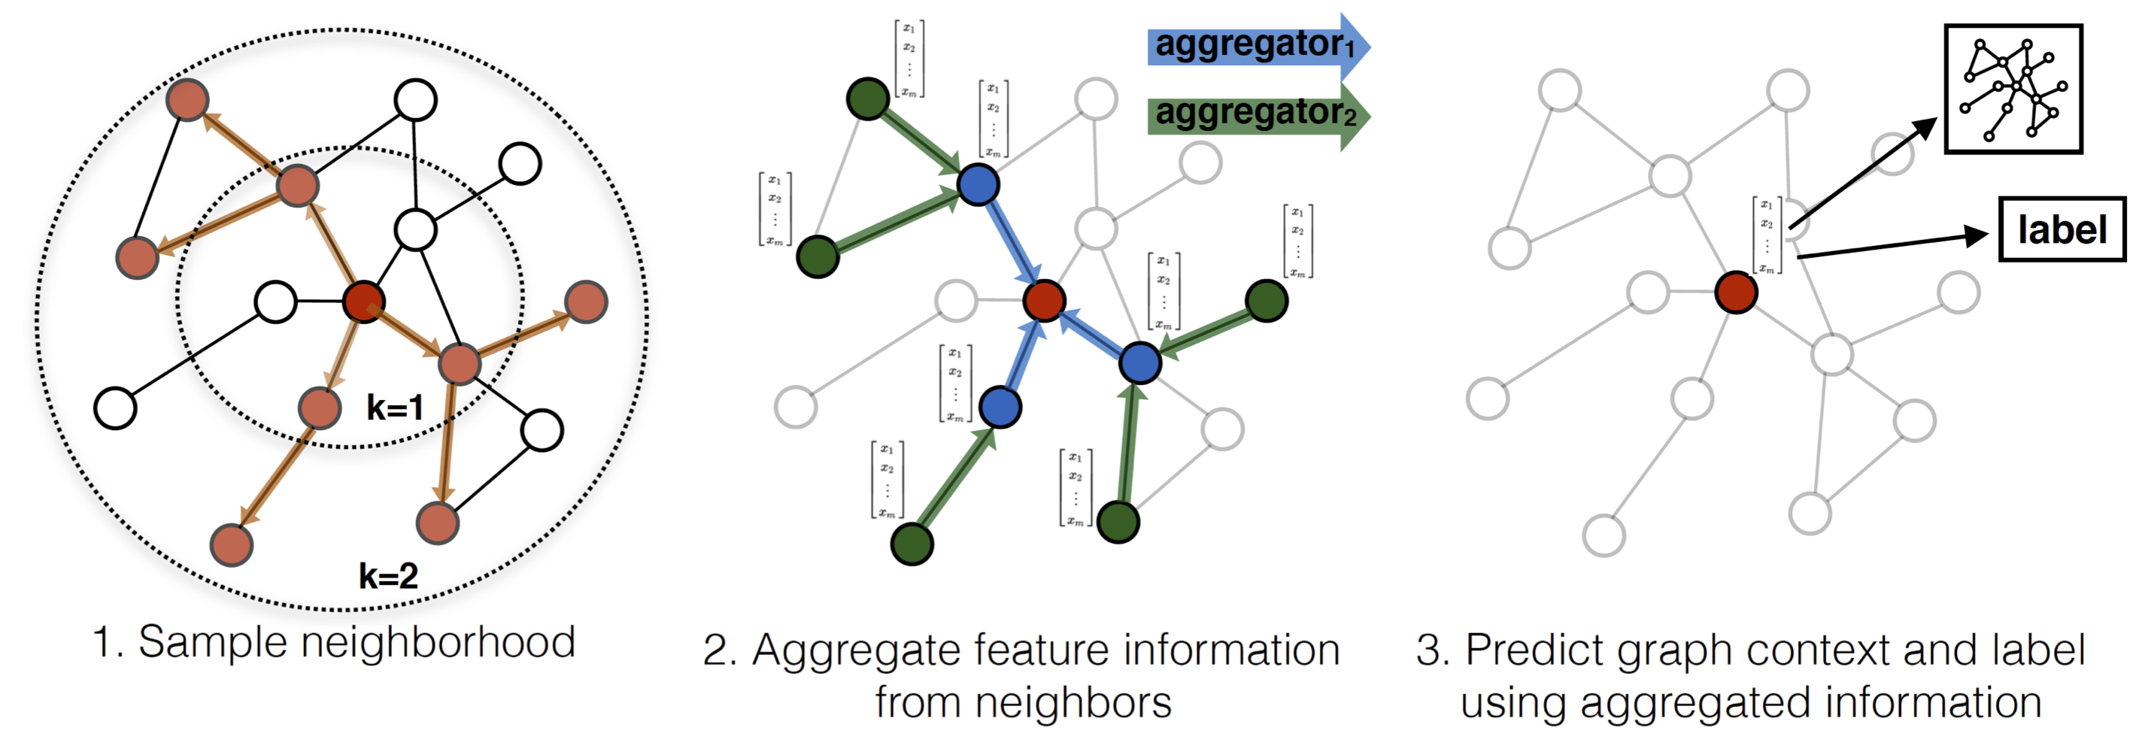
Graph Neural Networks: GraphSAGE

Slide 32
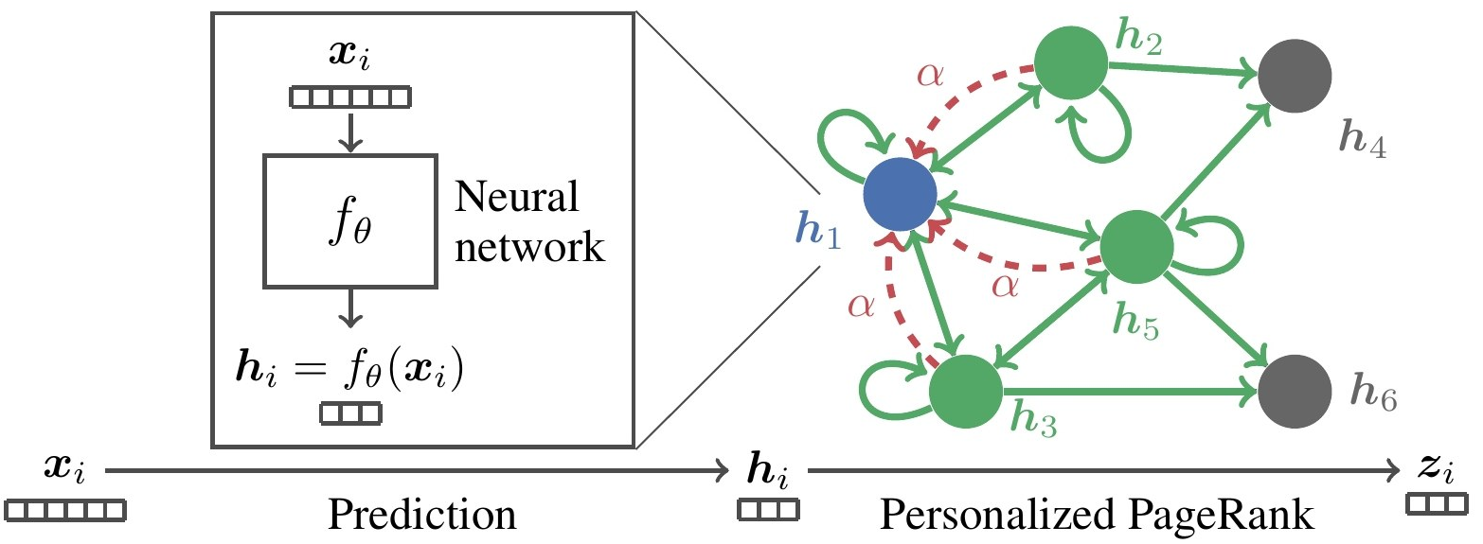
Graph Neural Networks: PageRank
Propagate + teleport: avoid over-smoothing

Slide 33
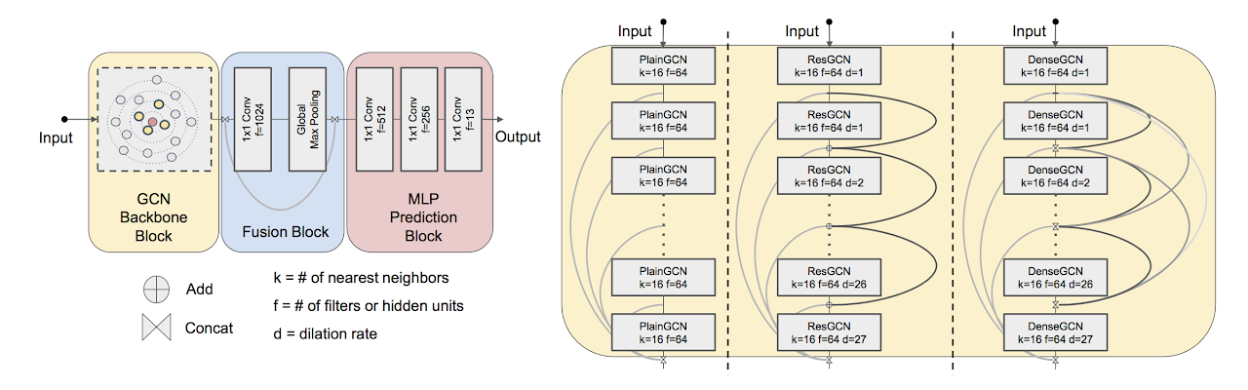
Graph Neural Networks: DeepGCN
Normal GNN: 2 layers, or several layers
More layers lead to over-smoothing

Slide 34

Graph Neural Networks: DeepWalk
Inspired by Word2Vec
Transform graph into node sequences
v1 -> v2 -> v3 -> v4 -> v5
v2 -> v4 -> v6 -> v7 -> v8Treat sequences as symbol sentence and perform word2vec to extract representations.

Slide 35
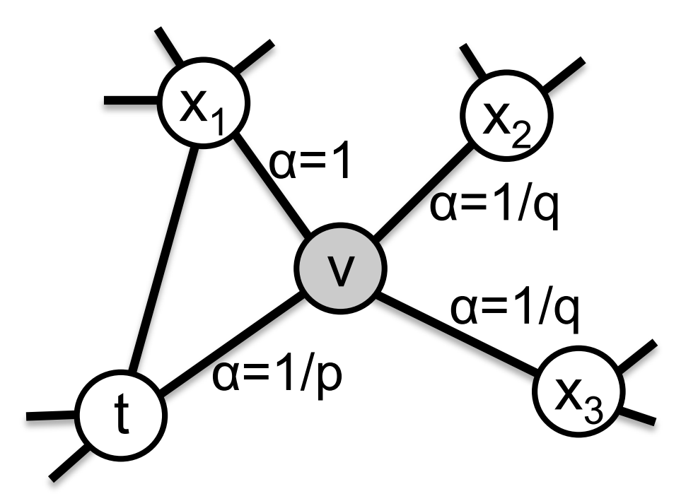
Graph Neural Networks: Node2Vec
Instead of using uniform random walk, Node2Vec parametrizes first- and second-order transition probability.

Slide 36
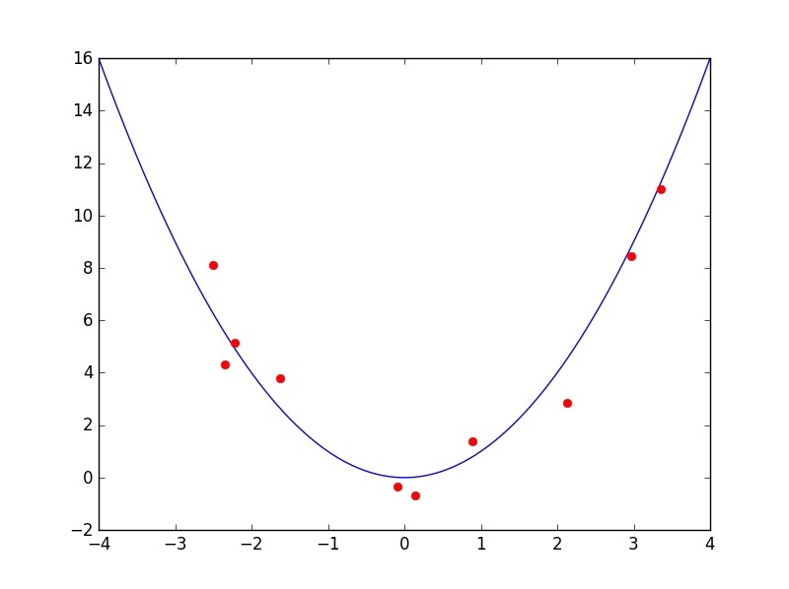
Function Approximation
Most GNN can be explained as polynomial/rational function of eigenvalues
Their pro/con can be explained by approximation theory

Slide 37
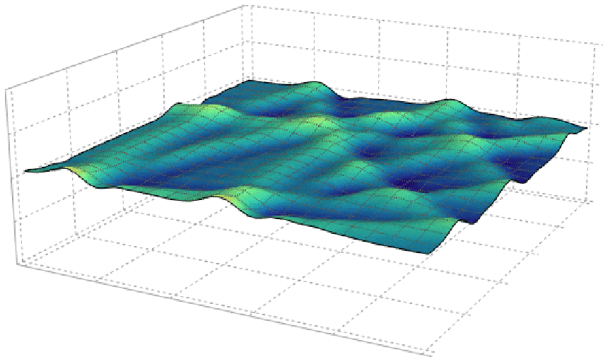
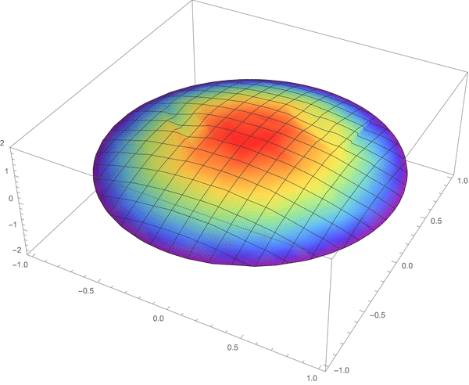
ODE/PDE
Current GNN are mostly discrete operation
Continuous GNN
ODE: w.r.t. time
PDE: w.r.t. time and others such as locations

Slide 38
Explainability
Interpretability v.s. Explainability
Interpretability
Solid theoretical support: approximation, ODE
White box: hard to find, require manual analysis
Explainability
Empirical, statistical demonstration
Black box: model-agnostic

Slide 39
Project Topics
Directed Graph Modeling
Model Neural Network as Graph
Graph Matching
Molecule/Protein Graph for Drug/Material Discovery
Theoretical Geometric Deep Learning
Influence Maximization/Minimization
Combinatorial Optimization on Graphs
Explainable AI for Graph Neural Networks

Slide 40
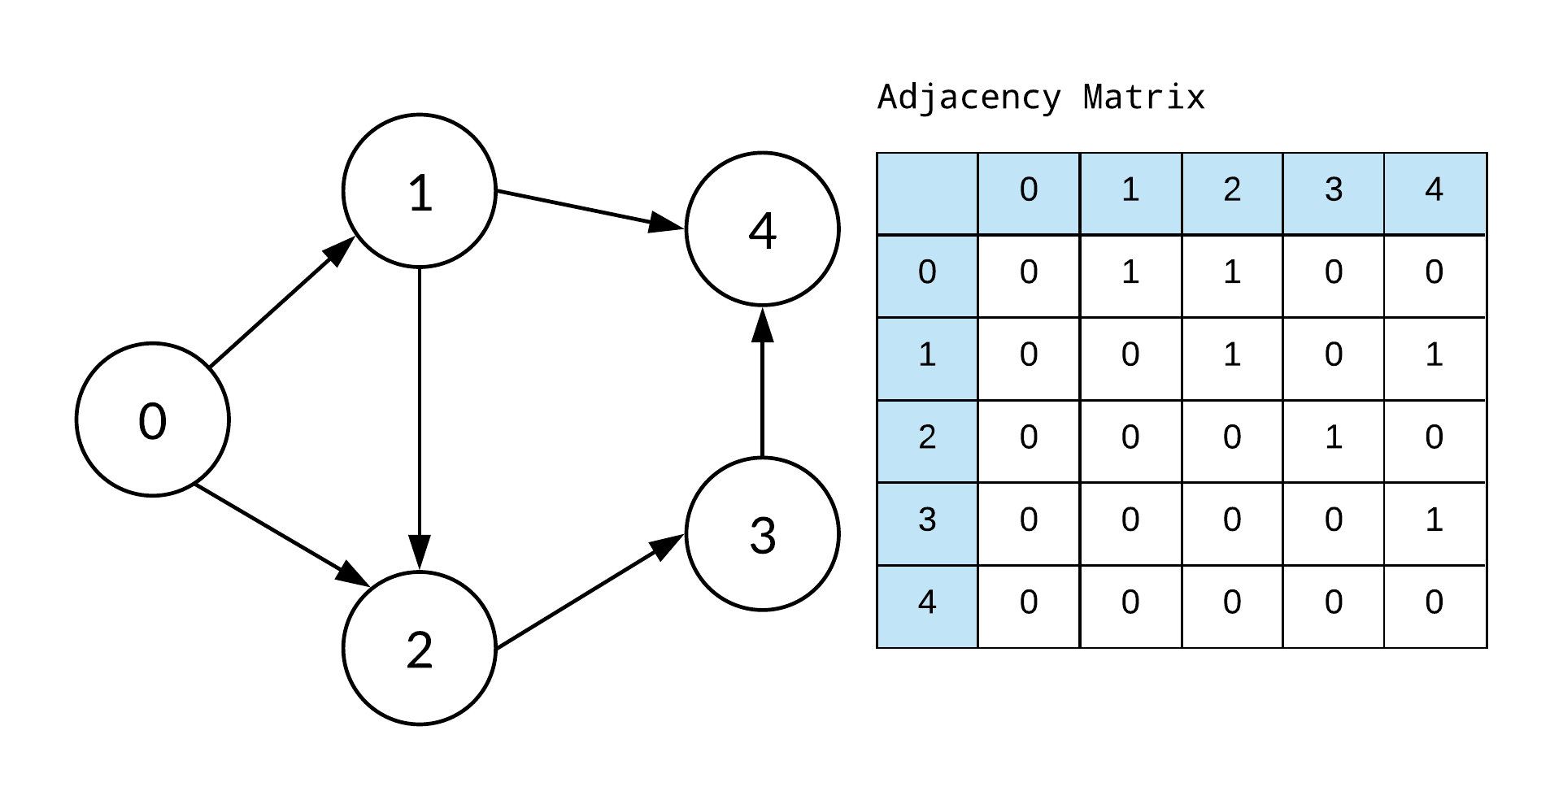
Directed Graph Modeling
Why important
More information
Challenges
Direction info will be encoded with non-symmetric adjacency or Laplacian

Slide 41
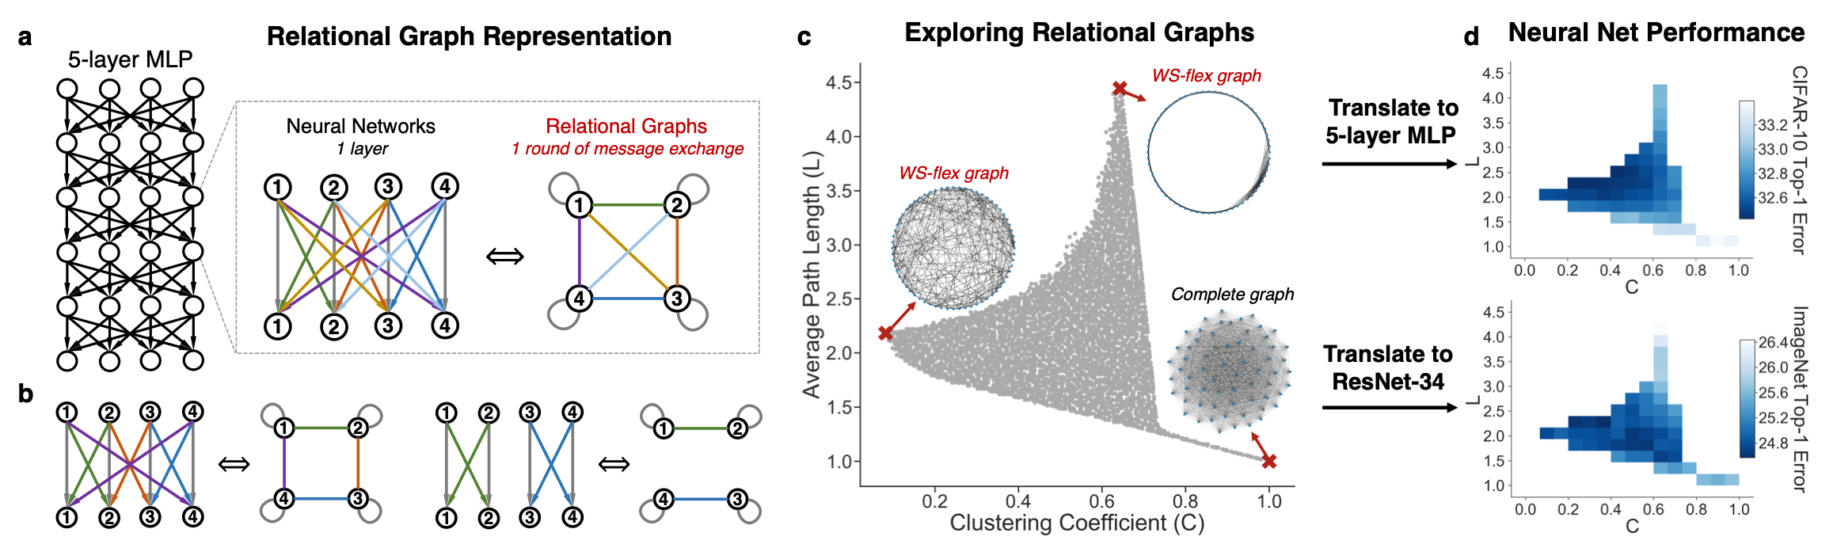
Model Neural Network as Graph
Pattern: NN performance <->Topology
You, Jiaxuan, Jure Leskovec, Kaiming He, and Saining Xie. "Graph structure of neural networks." In International Conference on Machine Learning, pp. 10881-10891. PMLR, 2020.

Slide 42
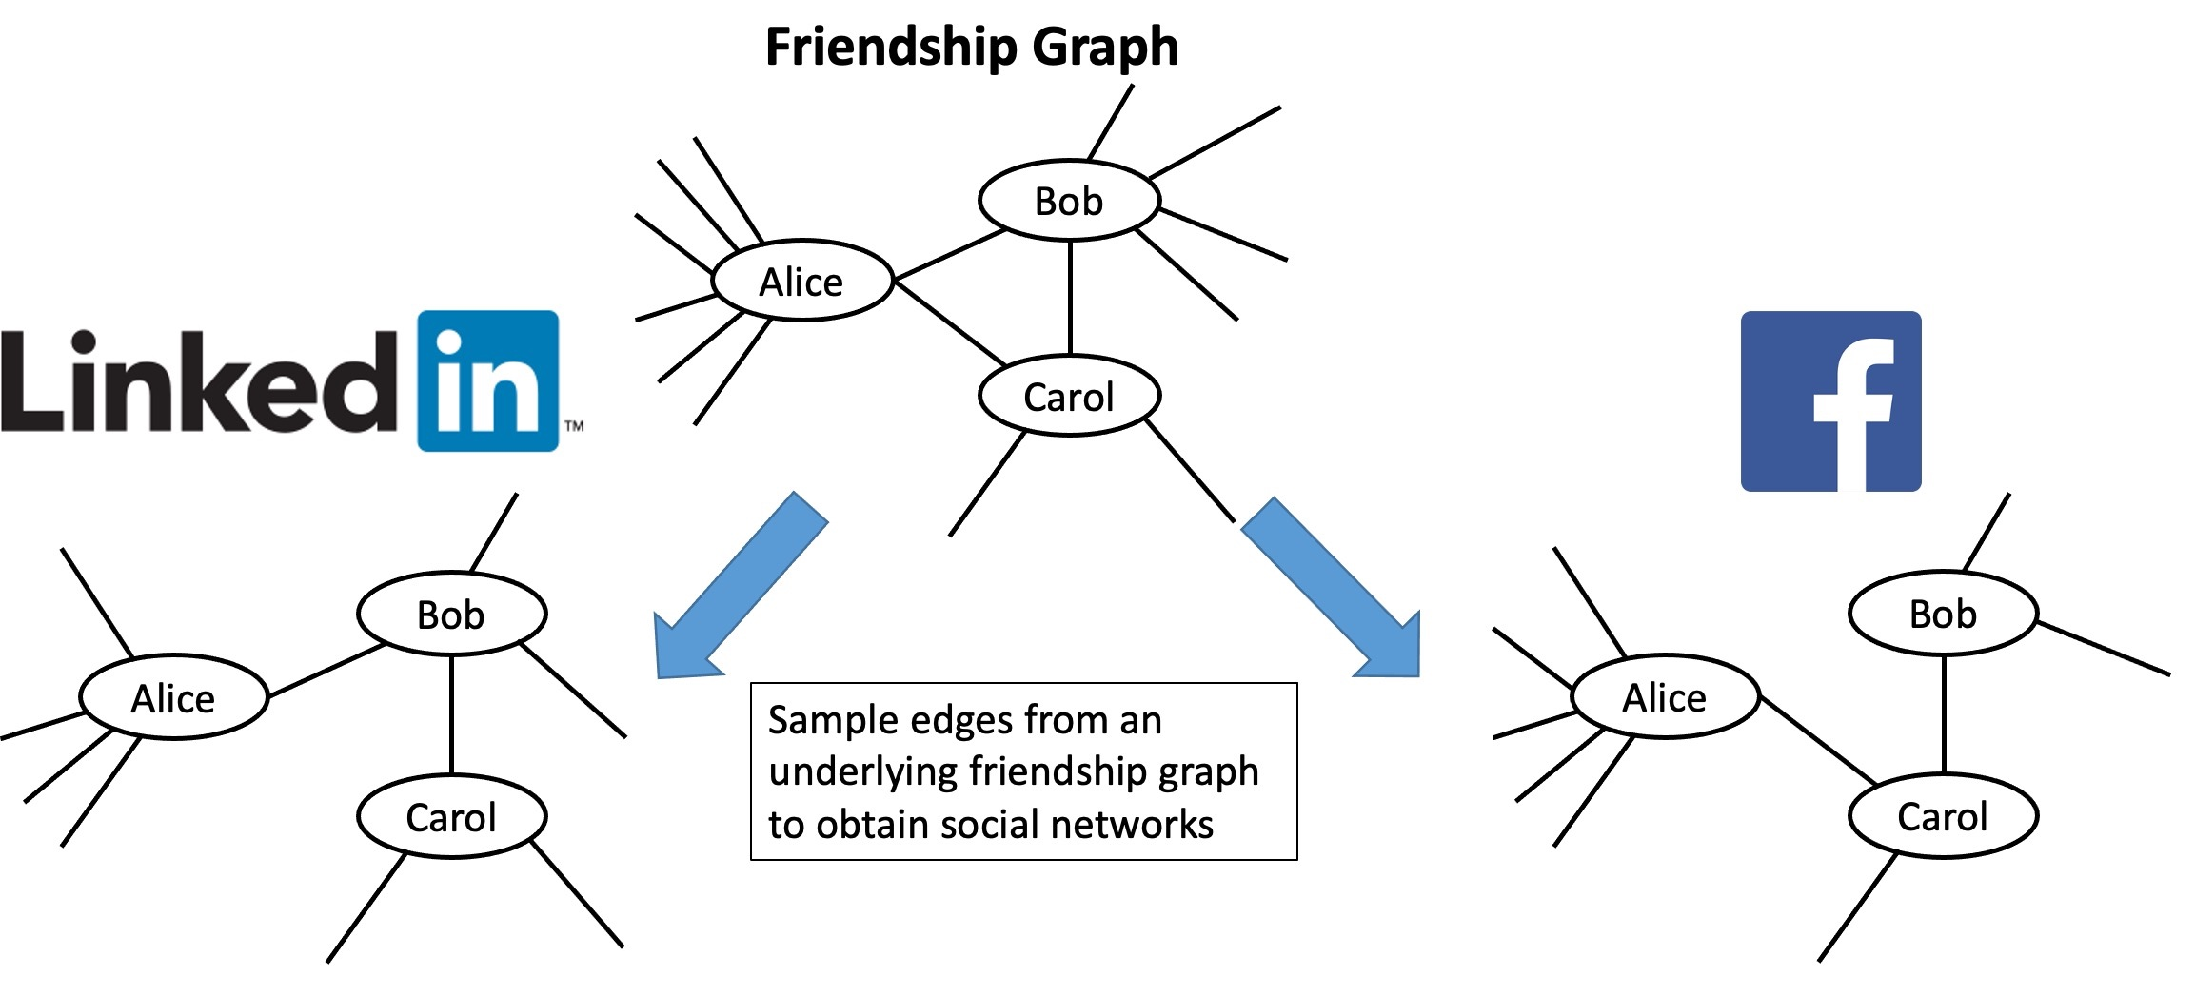
Graph Matching

Slide 43
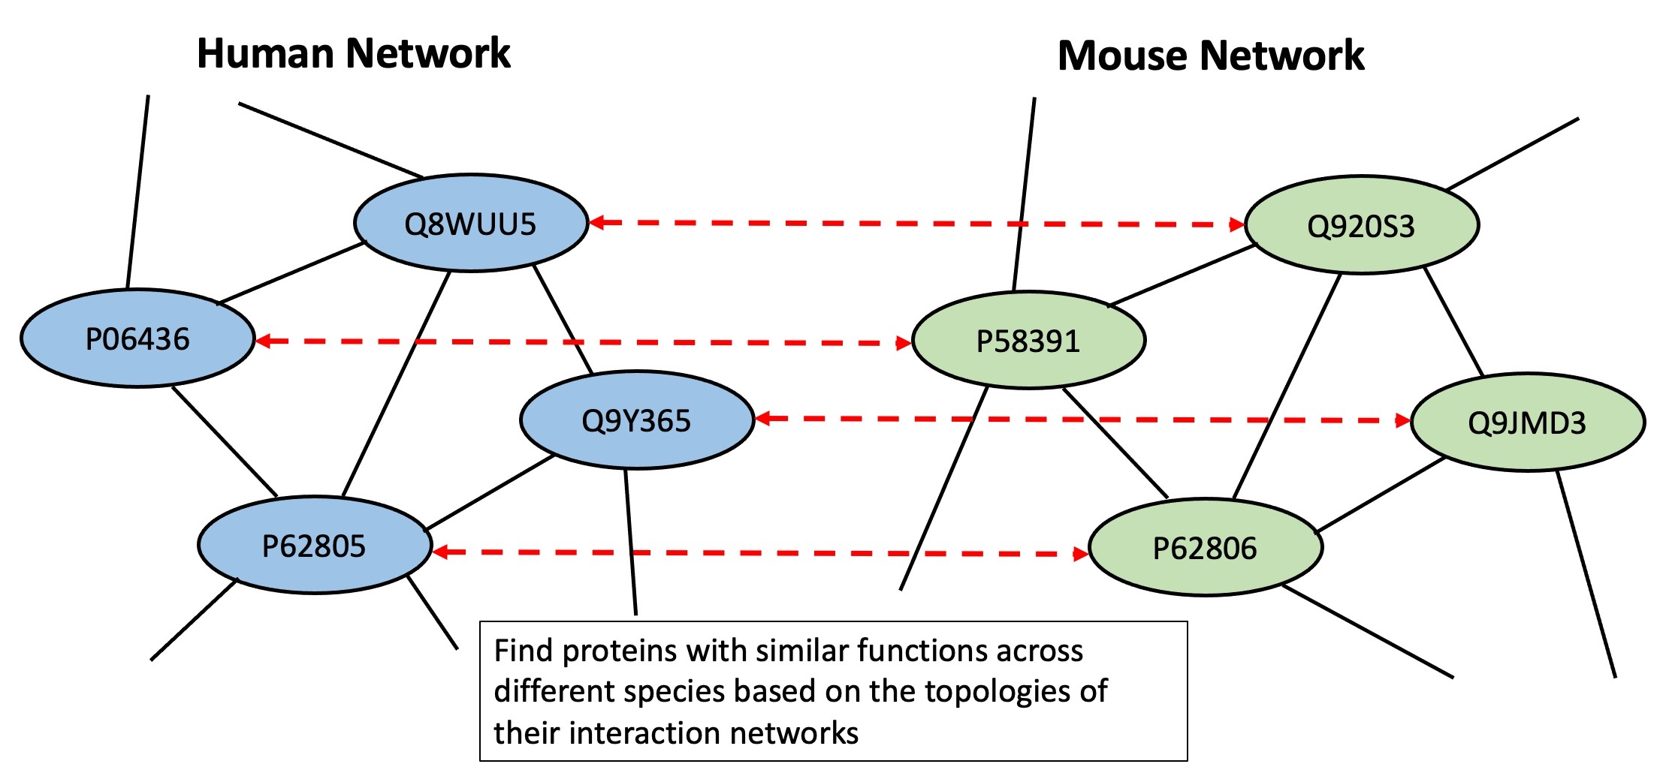
Graph Matching

Slide 44
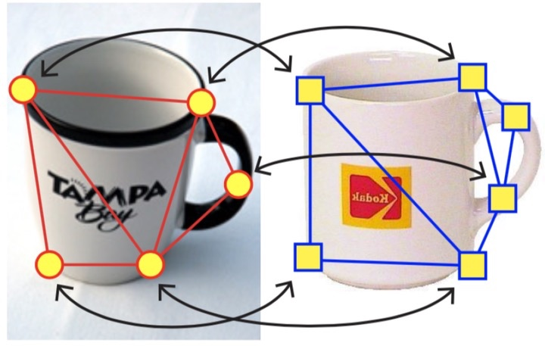
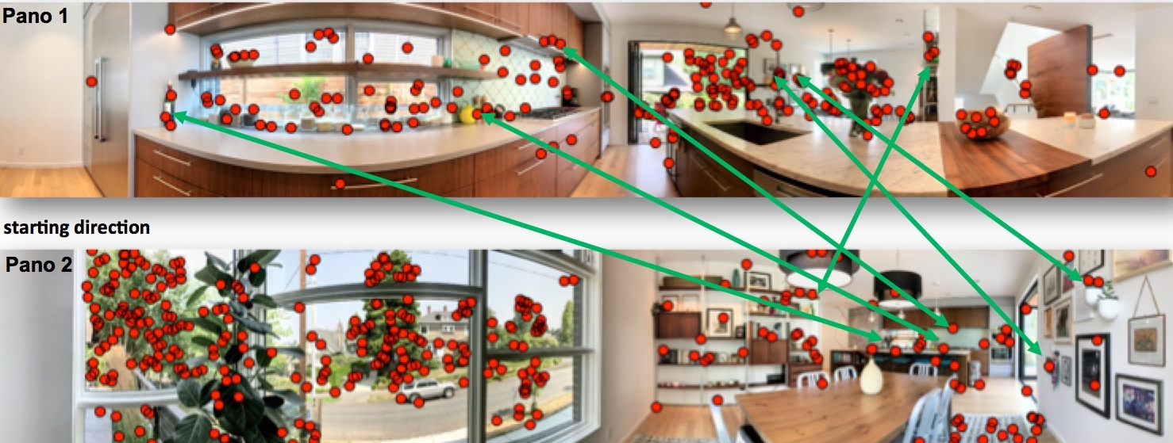

Slide 45
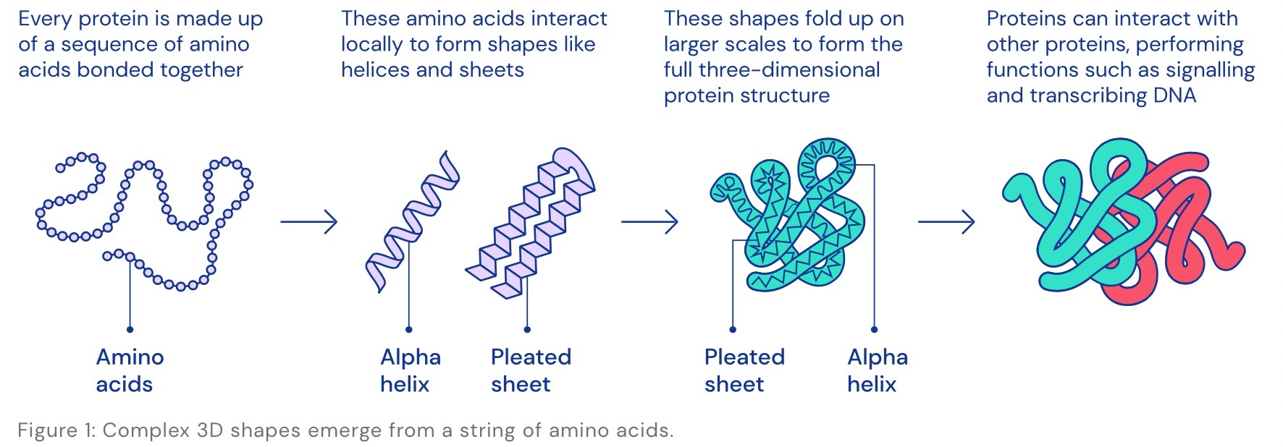
Molecule/Protein Graph for Drug/Material Discovery
Source: DeepMind

Slide 46
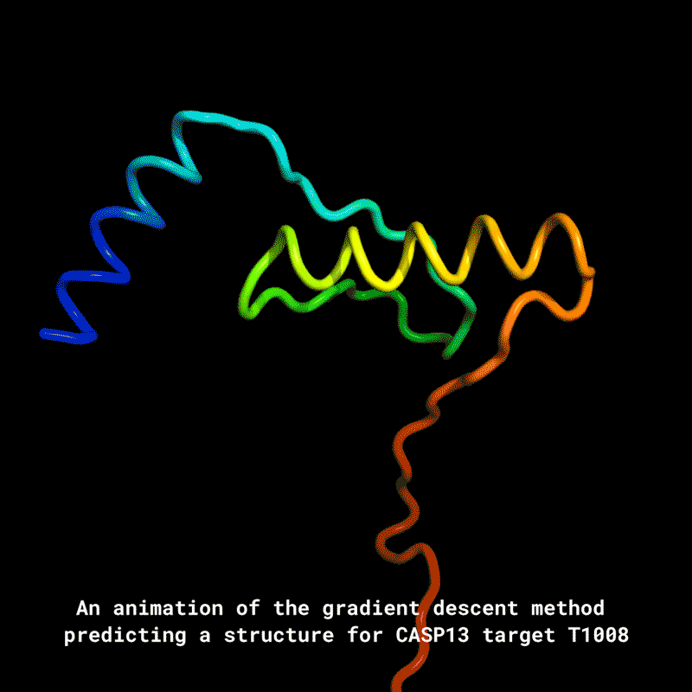
Molecule/Protein Graph for Drug/Material Discovery
Source: DeepMind

Slide 47
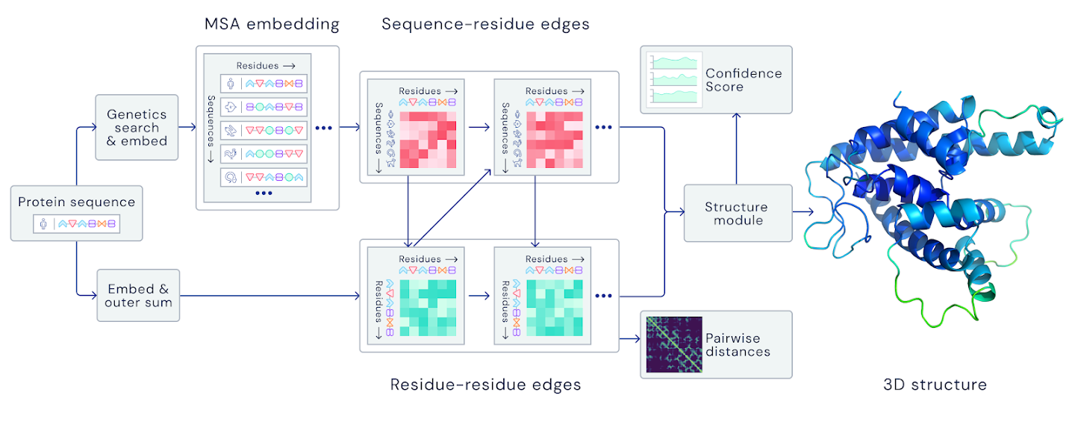
Molecule/Protein Graph for Drug/Material Discovery
“Spatial graph”
Nodes: Amino acids in a protein sequence Edges: Proximity between amino acids
Source: DeepMind

Slide 48
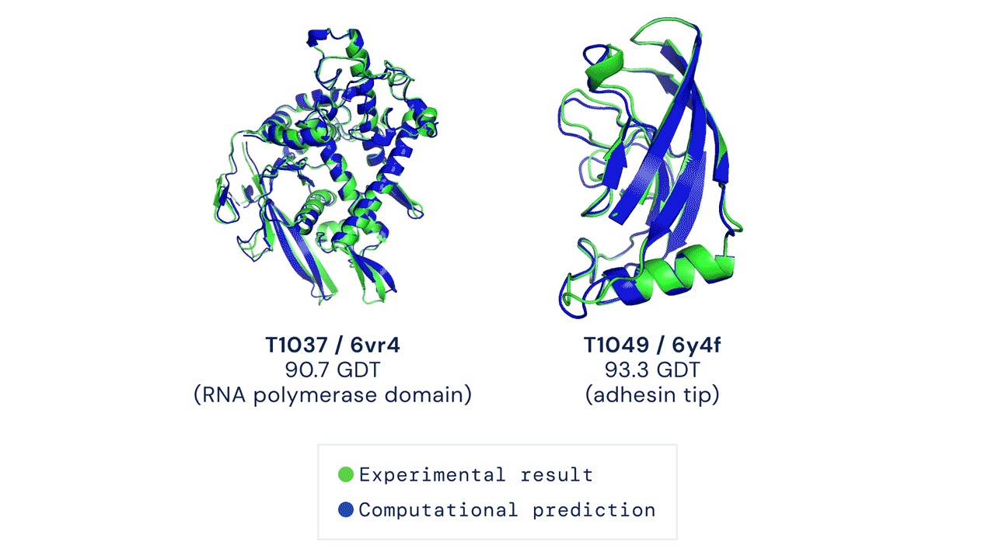
Molecule/Protein Graph for Drug/Material Discovery
Source: DeepMind

Slide 49
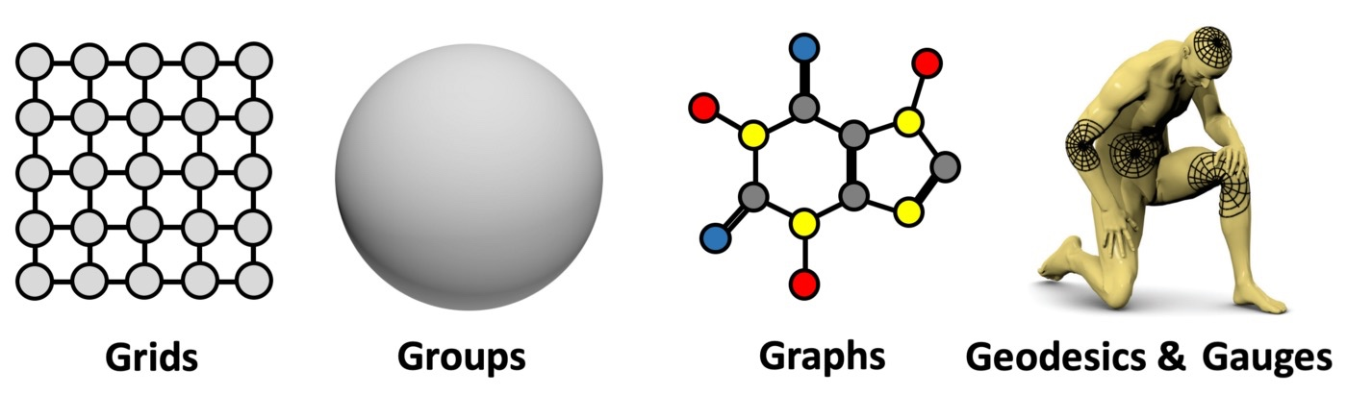
Theoretical Geometric Deep Learning

Slide 50
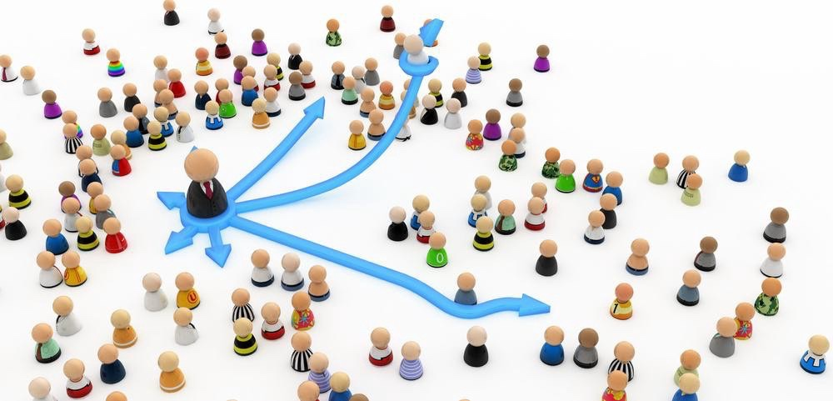
Influence Maximization/Minimization

Slide 51
Influence Maximization/Minimization
Problem:
Select up to K individuals, so that by activating them, the expected spread of influence is maximized
Applications:
information propagation, social networks, viral marketing, and epidemiology.

Slide 52
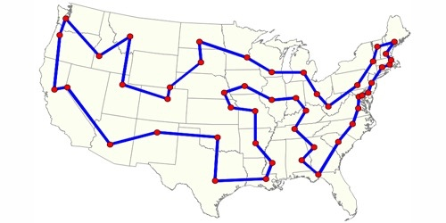
Combinatorial Optimization on Graphs
Traveling Salesman Problem (TSP)
Select cities (nodes) and their ordering
Minimize the cost (each city takes budget)
Goal: travel all the cities
NP hard

